Slide 1
Lecture 7
Network Models of Cities
7.1 Scaling of Infrastructure Networks and Urban Built Spaces
©Luís M. A. Bettencourt 2024
IUS 3.2.2
Notes:
We now start adding infrastructure. The objective will be to understand how a street network connects places of work and residence (buildings), and how it mediates costs of movement that cannot grow faster that benefits from interactions for there to be scale invariance (scaling) in urban properties.

Slide 2
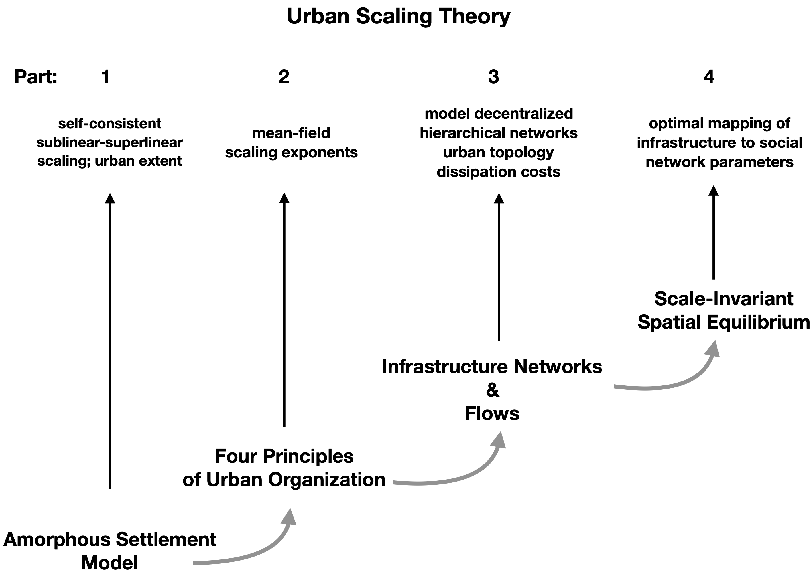

IUS Figure 3.5

Slide 3
Four Principles of Urban Organization
1) Cities are mixing populations (networks) over built space and time
2) Personal effort is limited
3) City infrastructure as decentralized but hierarchical networks
4) Socioeconomic products of cities are the result of interactions,
subject to spatial costs
Jacobs, Wirth, Burgess
Park, Milgram, Zahavi, Simon
Alexander
Jacobs
Alonso
already in the amorphous model, but more to come…

Slide 4
Let’s make a network theory of all this …

Slide 5
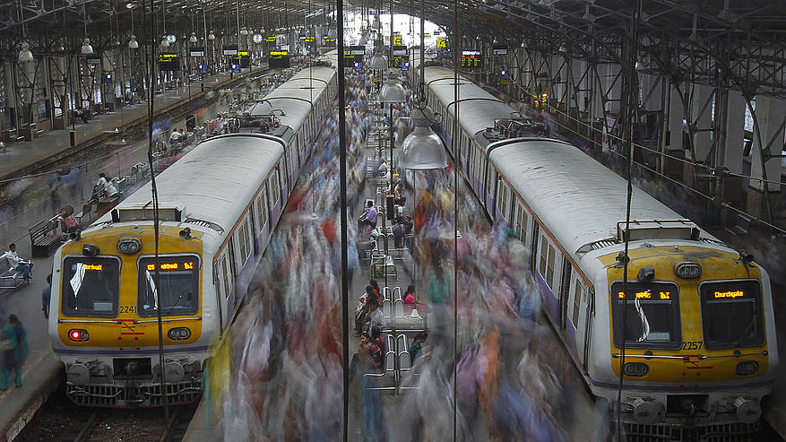
People interacting over the built environment:
fast (people, ~days) and slow (infrastructure, ~decade) time scales
Mumbai Train Station
credit: Randy Olson
note now that spaces are structured, not amorphous: we need to understand the nature of their networks
Notes:
The key to thinking about infrastructure is that it is the backdrop of human activities, the container and enabler of mobility, but that its characteristics change slowly. In this way we have a separation of time scales between changes in infrastructure and social dynamics.

Slide 6




IUS Fig 3.10
A socioeconomic network of diverse people
Notes:
Ok, so let’s imagine a social network of millions of diverse people…

Slide 7







IUS Fig 3.10
…can be abstracted in terms of an “ego-network”
Notes:
It helps for many purposes to concentrate on one person at the time (their ego network)

Slide 8

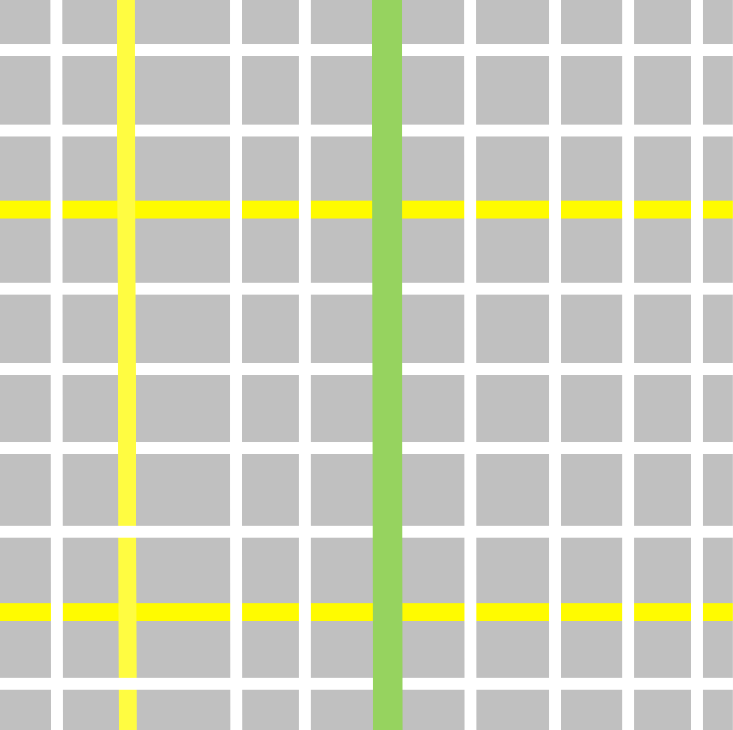

Health
Love
Money
Education
Fun
Food
Services
…
IUS Fig 3.10
…which is embedded in spacetime via life paths (time geography)
Notes:
And let’s put these interactions in the space-time of the city. To do this, we introduce a beautiful (and intuitive) concept from ‘time geography’ called the life path (this is the person’s trajectory in (urban) space-time; in physics the same concept is known as the worldline). Every one has a worldline, and big tech companies will keep track of yours, if you let them. This is not an abstract concept: you can measure life paths, e.g. with mobile devices.

Slide 9

Health
Love
Money
Education
Fun
Food
Services
…
IUS Fig 3.10
…which is embedded in spacetime via life paths, which meet more events in larger, denser, more heterogeneous cities
Notes:
The idea now, as you go to a larger city is that with the same effort, there are more people and things to do around, and the rates of socioeconomic interaction (and production) increase to the extent that the (built space) density of interactions increases. In addition, as we shall see, the infrastructure changes to include faster and larger volume flows, such as via highways and subways, and houses tend to get a little smaller (more on that soon). This sequence of pictures is essential what we will propose as a theory of urban scaling.

Slide 10
The Structure of Built Spaces in Cities
Streets and City Blocks also form networks

Slide 11
credit:Braun & Hogenberg / Ozgur Tufekci
Notes:
Backtracking a bit, we want to be able to say something general about the infrastructural spaces of cities. This old (and simple) map of the beautiful city of Lisbon (where I grew up) makes the point well: buildings exist embedded in a network of streets and squares, which provide access between them.

Slide 12
Notes:
A zoom in establishes the generality of this statement: note that buildings now form blocks (sort of like islands), which can take very different shapes, but are compact (expose each of the buildings to the street, for access). If you don’t like Lisbon, do find maps of your favorite city that show this effect. This also shows that these properties are very general and not just characteristic of modern cities.

Slide 13
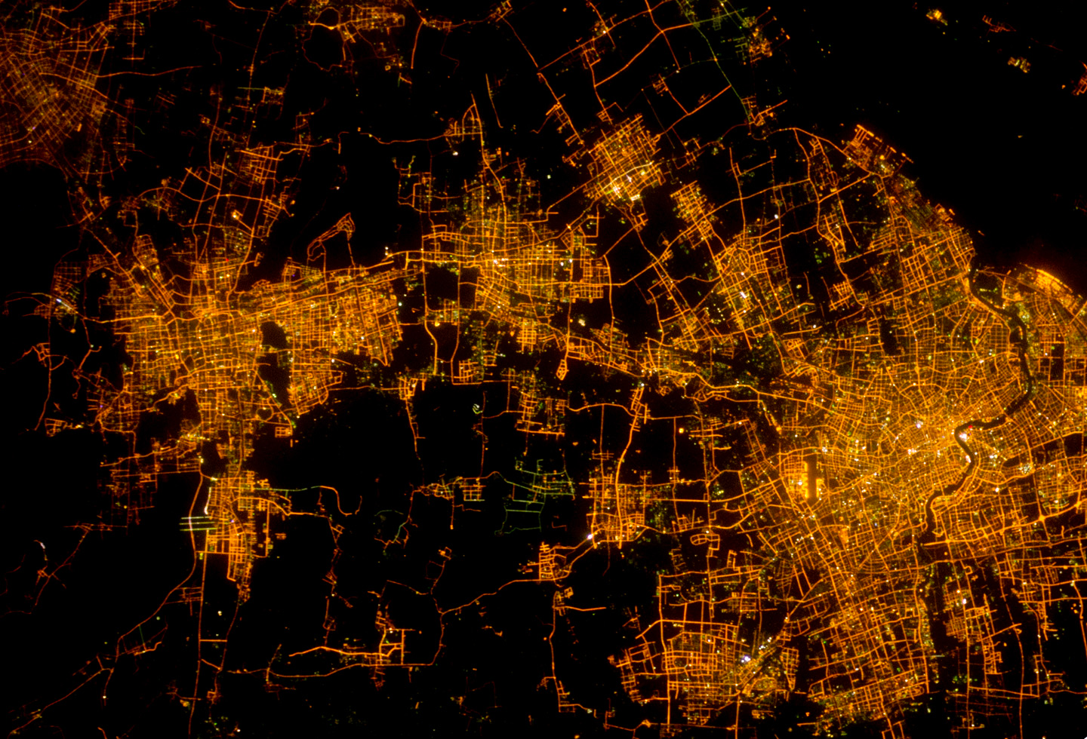
Shanghai credit:NASA
Notes:
You can see the two types of spaces beautifully in high res photographs from the space station.

Slide 14
How does this work?
Amorphous Settlement
R
Notes:
What all this means is that, to go fro the amorphous settlement to networked settlements…

Slide 15
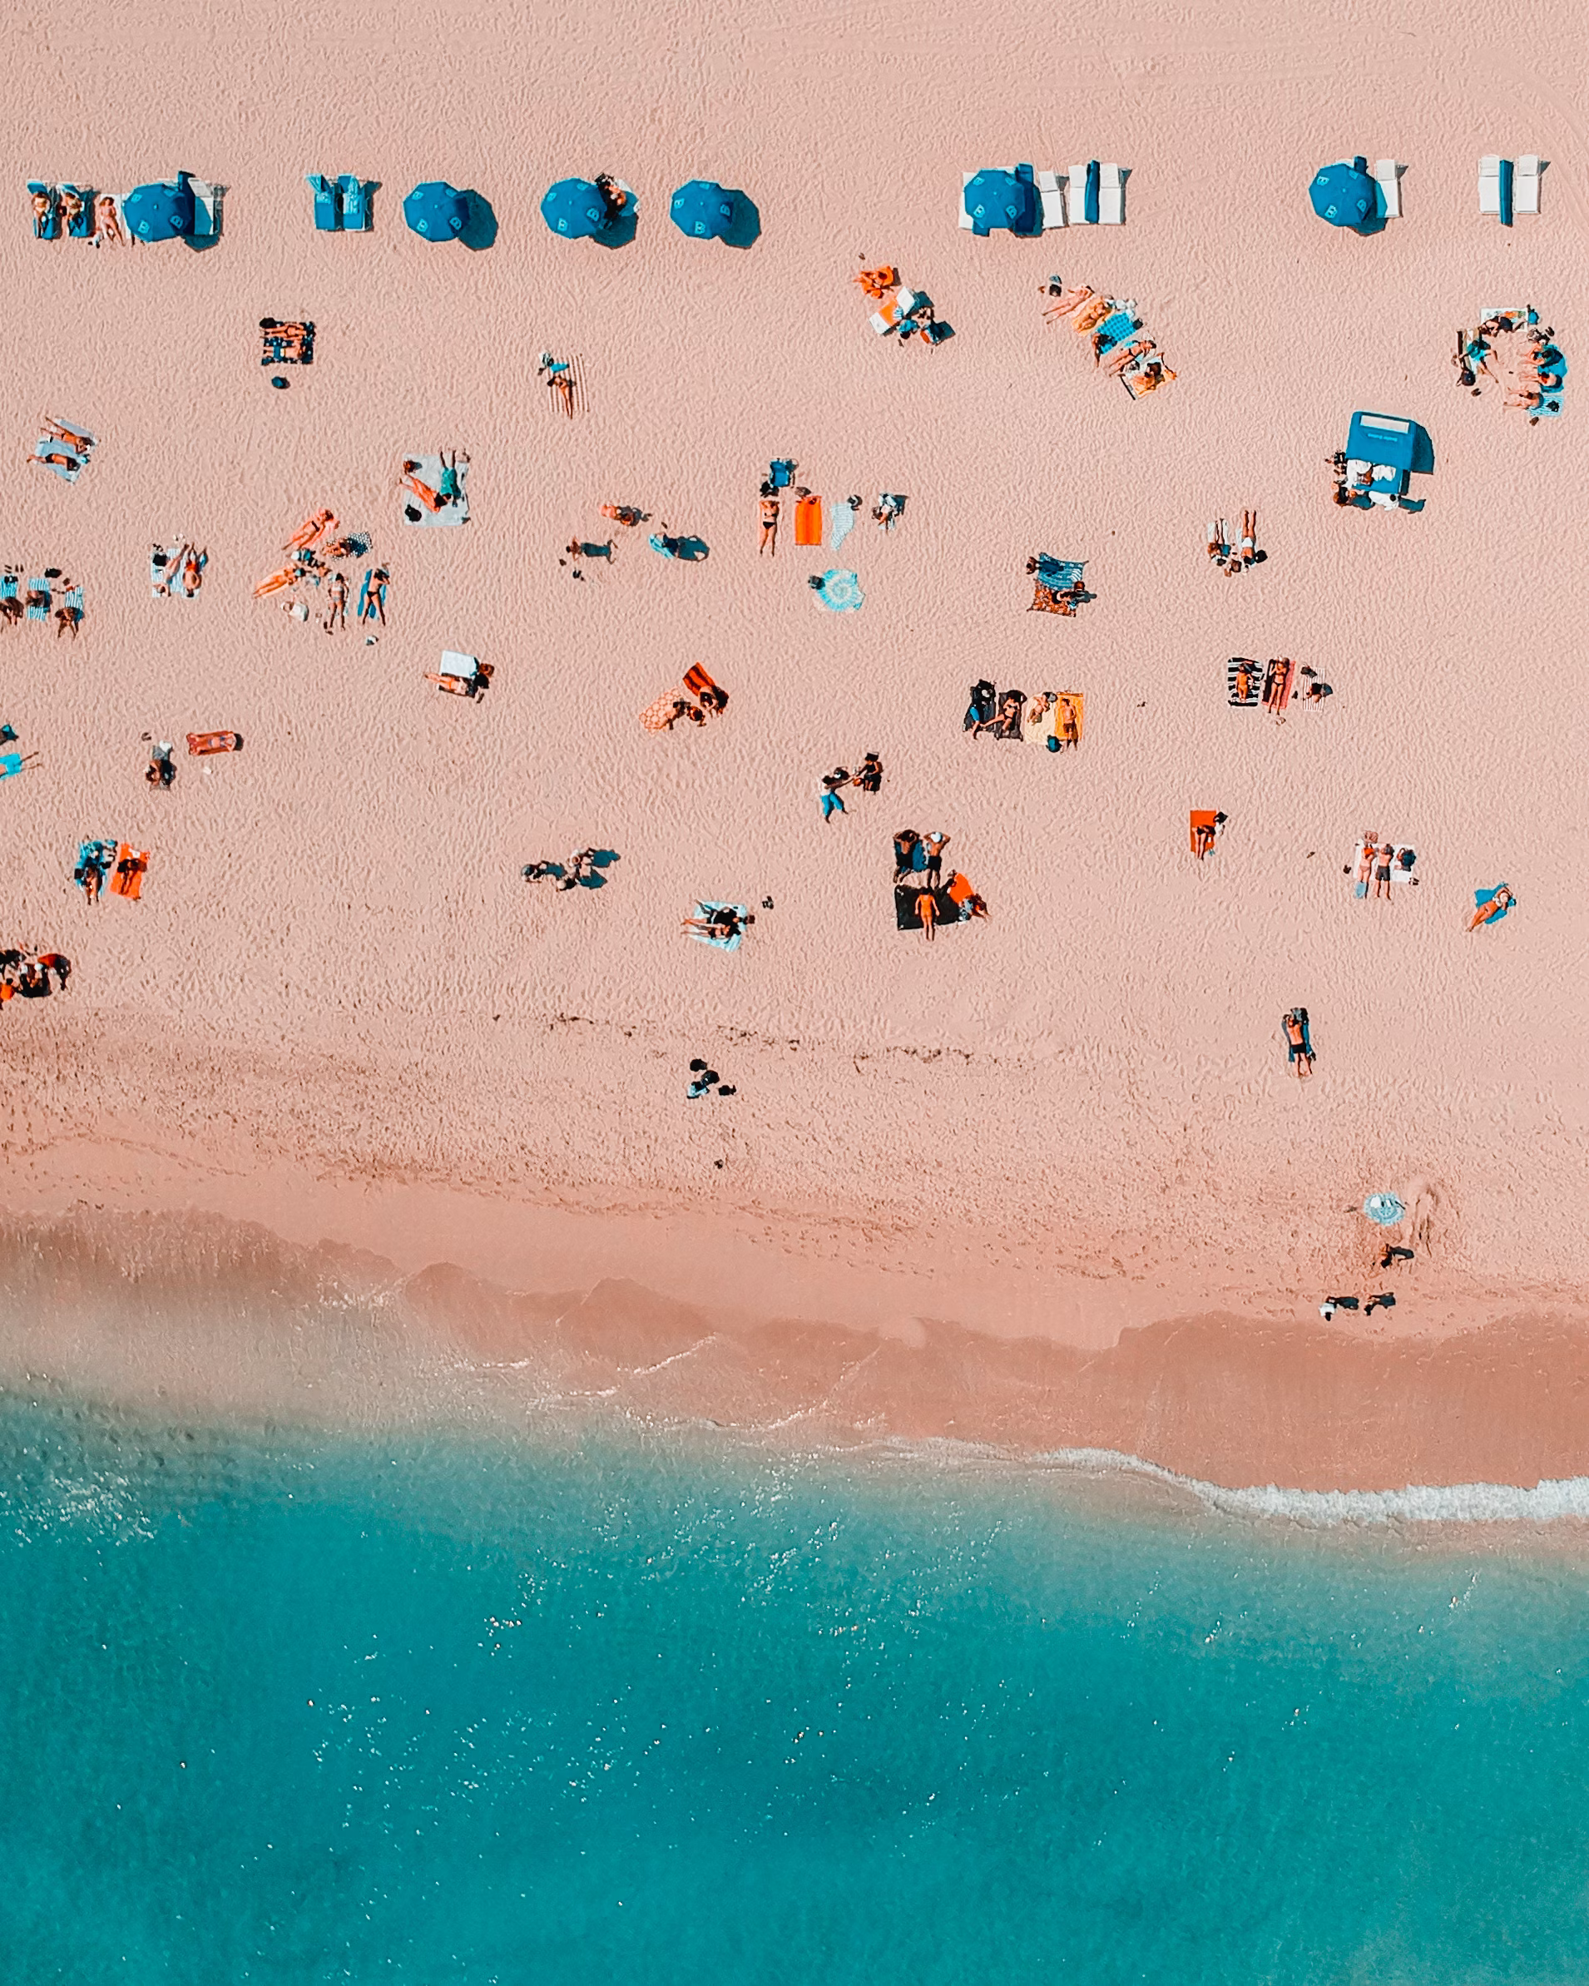
Where will you go?
Miami Beach

Slide 16
Where will you go?
Miami Beach

Slide 17
Where will you go?
Average distance is set by density
$$A(N)=aN^{\frac{2}{3}}→\frac{A}{N}∼N^{-\frac{1}{3}}$$
$$d_{A}={\left(\frac{A}{N}\right)}^{1/2}∼N^{-\frac{1}{6}}$$
Miami Beach

Slide 18


Decentralized Networks
The volume of infrastructure grows faster than land
An ~ $d_{A}$ N~N^{5/6} $d_{A}$= (A/N)^{1/2}
Networked Settlement
$$δ=\frac{1}{6}$$
Y= G N N/An ~ G N^{7/6}
Social interactions accelerate
IUS pp 77
Notes:
We must align buildings along streets, we will need a little extra street per building, set by the overall density of the city, which immediately estimates the exponent of 5/6 for the area of infrastructure. We will reserve this later in more abstract and mathematical form…

